Slide 1
Unified Modeling Language (UML) Case Study

Slide 2
Case study: BookShop System
This Case study will show the way to use UML design for modeling an "Online Book Store“

Slide 3
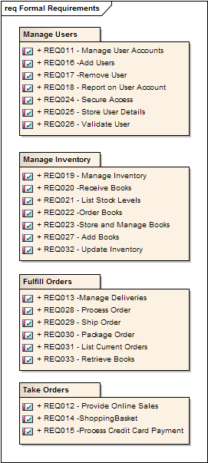
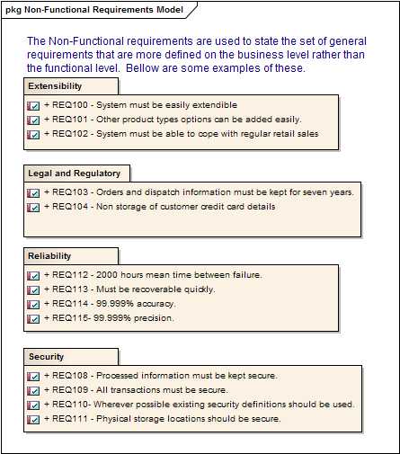
Case study: BookShop System Formal + Non-Functional Req

Slide 4
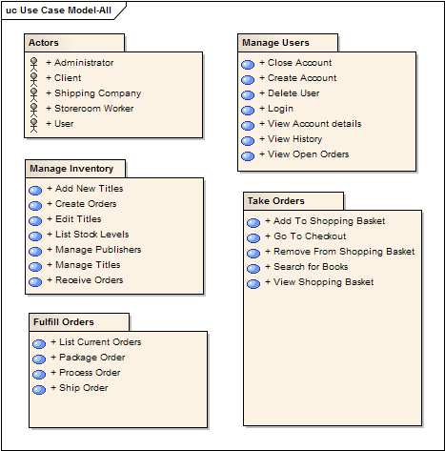
Case study: BookShop System Use-Cases Model

Slide 5
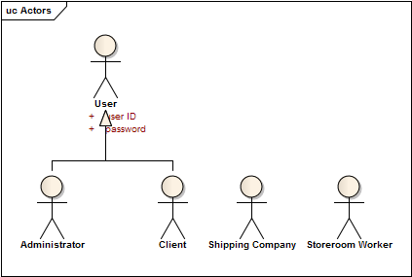
Case study: BookShop System Use-Cases Model – Actor Diagram

Slide 6
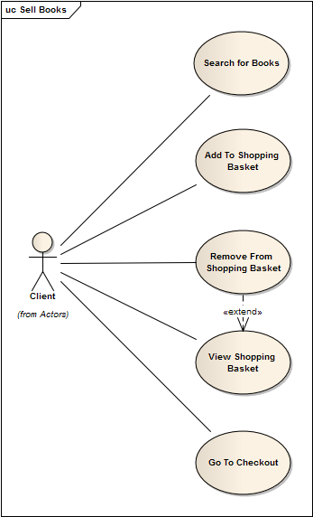
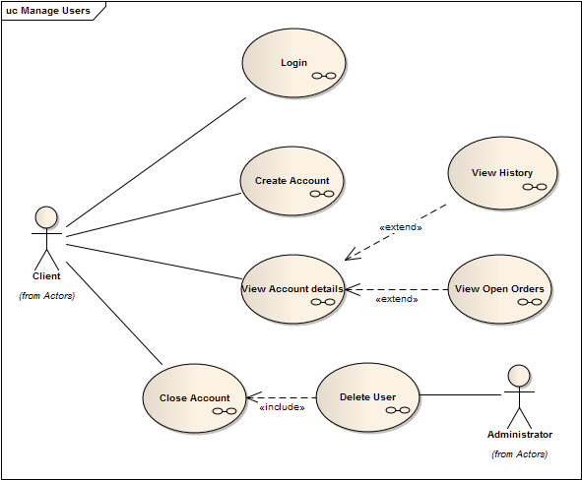
Case study: BookShop System Use-Cases Model – UseCase Diagram

Slide 7
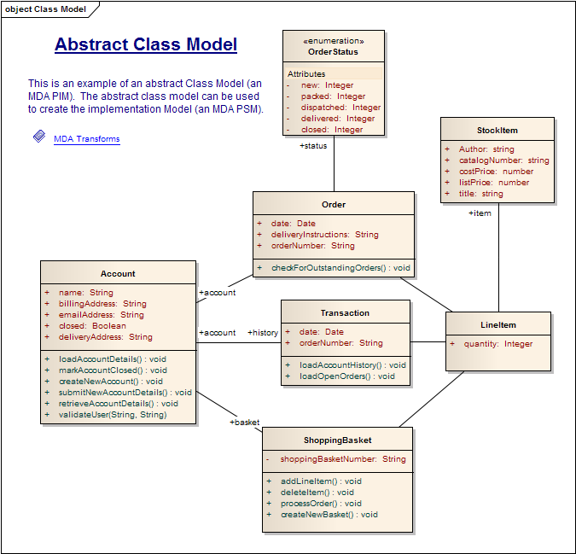
Case study: BookShop System Class Diagram

Slide 8
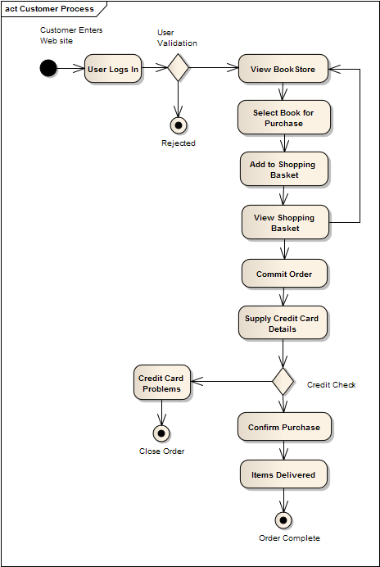
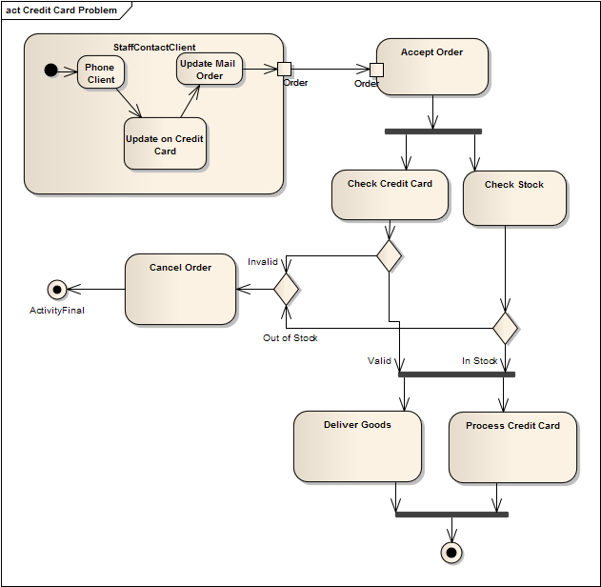
Case study: BookShop System Activity Diagram (1)

Slide 9
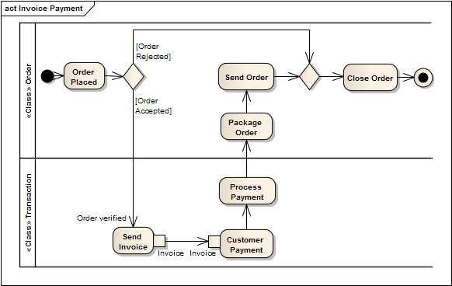
Case study: BookShop System Activity Diagram (2)

Slide 10
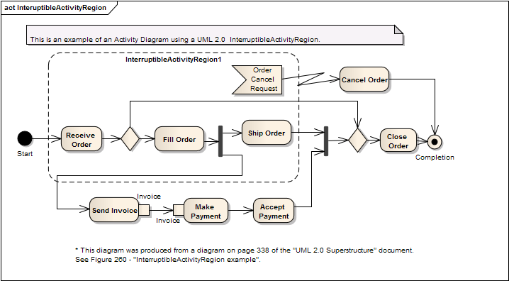
Case study: BookShop System Activity Diagram (3)

Slide 11
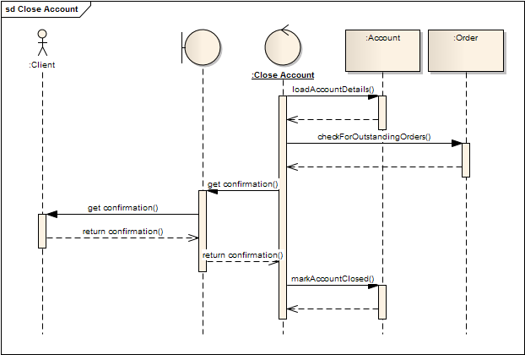
Case study: BookShop System Sequence Diagram

Slide 12
Resources & references
Resources
http://en.wikipedia.org/wiki/Unified_Modeling_Language
Technical CD in Rational Rose software
EAExample.eap (EA 8.0)
Recommended readings
The unified modeling language reference manual
UML Tools:
Enterprise Architect (EA - http://www.sparxsystems.com.au/)
Visio
Rational Rose

Slide 13
Thank you
Question & Answer

